Slide 1
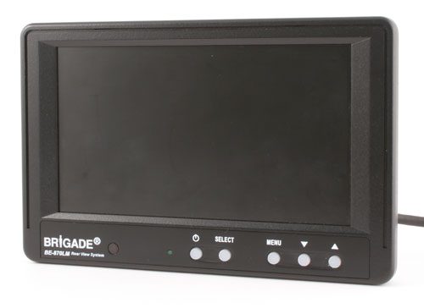
BE-870LM

Slide 2
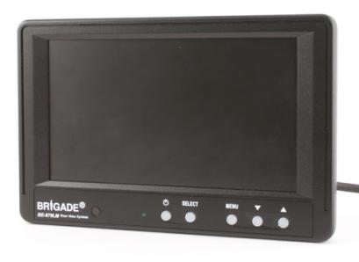
BE-870LM Features
Scan Feature
High Resolution TFT LCD
Adjust up/down and Mirror/Normal per channel for overhead or Left/Right mounting
2 camera input
OSD menu with 4 languages
Tamperproof function
Notes:
Languages; English, French, German, Italian and Spanish

Slide 3
BE-870M Features
Hot Key Function
  Brightness, Contrast and Colour
Trigger delay (0~20 secs)
Display Mode (16:9 or 4:3)
Auto Power Mode

Slide 4
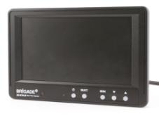
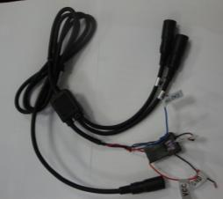
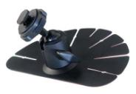

BE-870LM Component
1 x Monitor
1 x Main power harness
1 x Monitor Bracket
1 x Sunvisor
4 x pcs of fixing screws for the Monitor bracket

Slide 5
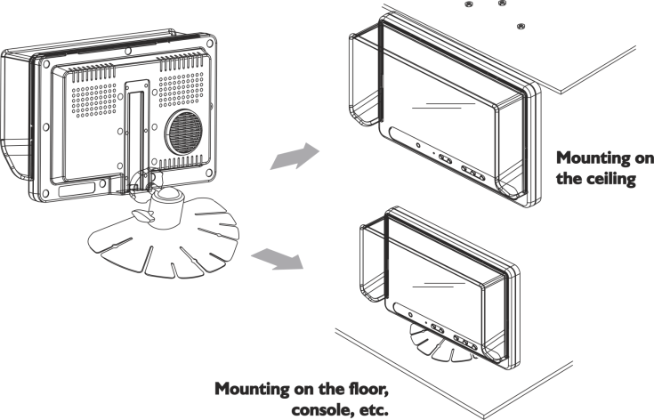
Monitor Installation
Notes:
Also it can be mounted on the windscreen

Slide 6
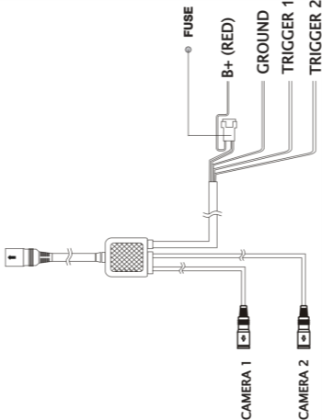
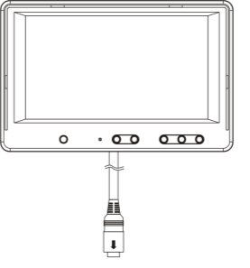
Monitor Connection

Slide 7
BE-870LM Specification
Operating Voltage: 10V~32 Vdc
TV System: PAL or NTSC
Panel Size: 7.0”
Resolution: 480(H) x 3(RGB) (V) x 234 (W)
Contrast Ratio: 250:1
Brightness: 450 cd/m²
Viewing Angle: 30(T), 60(B), 60(L), 60(R)
Operating Temperature: -40°Cto +70°C
Storage Temperature: -40°Cto +85°C
Vibration Rating: 10G

Slide 8
Compatible - Camera
BE-800C /BE-890C/BE-990C/BE-820C Series
BE-300C series
VBV-700C*/VBV-790C*/VBV-485C*/VBV-475C*
MD-50
DMC- series
FLIR
NOT compatible with
BE-810C – Shutter camera
BE-840C/BE-840RC – Tilt camera
Note: * Cable adaptors needed at the camera end , AC-006 or AC-020 at the monitor end and then add VBV-Lxxx.

